Slide 1
Session 4
White-Box Testing
——3.5 Data Flow Testing
苏州大学计算机科学与技术学院 程宝雷

Slide 2
Dataflow Coverage
Based on the idea that program paths along which variables are defined and then used should be covered.
A family of path selection criteria has been defined, each providing a different degree of coverage.

Slide 3
Data Flow Testing
definition-use path
definition-clear path

Slide 4
Variable Definitions and Uses
A program variable is DEFINED when it appears:
  on the left hand side of an assignment statement (e.g., Y := 17)
  in an input statement (e.g., input(Y))
  as an OUT parameter in a subroutine call (e.g., DOIT(X:IN,Y:OUT))

Slide 5
Variable Definitions and Uses (cont’d)
A program variable is USED when it appears:
  on the right hand side of an assignment statement (e.g., Y := X+17)
  as an IN parameter in a subroutine or function call (e.g., Y := SQRT(X))
  in the predicate of a branch statement (e.g., if X>0 then...)

Slide 6
Variable Definitions and Uses (cont’d)
Use of a variable in the predicate of a branch statement is called a predicate-use (“p-use”). Any other use is called a computation-use (“c-use”).
For example, in the program statement:
If (X>0) then
print(Y)
end_if_then
there is a p-use of X and a c-use of Y.

Slide 7
Variable Definitions and Uses (cont’d)
A variable can also be used and then re-defined in a single statement when it appears:
  on both sides of an assignment statement (e.g., Y := Y+X)
  as an IN/OUT parameter in a subroutine call (e.g., INCREMENT(Y:IN/OUT))

Slide 8
Other Dataflow Terms and Definitions
A definition-use pair (“du-pair”) with respect to a variable v is a double (d,u) such that d is a node in the program’s flow graph at which v is defined, u is a node or edge at which v is used。
Note: Broad definition.

Slide 9
Example 1
1. input(A,B)
if (B>1) then
2. A := A+7
end_if
3. if (A>10) then
4. B := A+B
end_if
5. output(A,B)
input(A,B)
1
B>1
B≤1
2
A := A+7
3
A>10
A≤10
4
B := A+B
5
output(A,B)

Slide 10
Identifying DU-Pairs – Variable A
du-pair | path(s)
(1,2) | <1,2>
(1,4) | <1,3,4>
(1,5) | <1,3,4,5>
 | <1,3,5>
(1,<3,4>) | <1,3,4>
(1,<3,5>) | <1,3,5>
(2,4) | <2,3,4>
(2,5) | <2,3,4,5>
 | <2,3,5>
(2,<3,4>) | <2,3,4>
(2,<3,5>) | <2,3,5>
input(A,B)
1
B>1
B≤1
2
A := A+7
3
A>10
A≤10
4
B := A+B
5
output(A,B)

Slide 11
Exercise
1. input(X,Y)
2. while (Y>0) do
3. if (X>0) then
4. Y := Y-X
else
5. input(X)
end_if_then_else
6. end_while
7. output(X,Y)
1
input(X,Y))
2
Y>0
Y≤0
3
X≤0
X>0
input(X)
5
4
Y := Y-X
6
7
output(X,Y)

Slide 12
Identifying DU-Pairs – Variable X
du-pair | path(s)
(1,4) | <1,2,3,4>
 | <1,2,3,4,(6,2,3,4)*>
(1,7) | <1,2,7>
 | <1,2,3,4,6,2,7>
 | <1,2,3,4,6,(2,3,4,6)*,2,7>
(1,<3,4>) | <1,2,3,4>
 | <1,2,3,4,(6,2,3,4)*>
(1,<3,5>) | <1,2,3,5>
(5,4) | <5,6,2,3,4>
 | <5,6,2,3,4,(6,2,3,4)*>
1
input(X,Y))
2
Y>0
Y≤0
3
X≤0
X>0
input(X)
input(X)
5
4
Y := Y-X
6
7
output(X,Y)

Slide 13
Identifying DU-Pairs – Variable X
du-pair | path(s)
(5,7) | <5,6,2,7>†
 | <5,6,2,3,4,6,2,7>
 | <5,6,2,3,4,6,(2,3,4,6)*,2,7>
(5,<3,4>) | <5,6,2,3,4>
 | <5,6,2,3,4,(6,2,3,4)*>
(5,<3,5>) | <5,6,2,3,5>
 | <5,6,2,3,4,6,2,3,5>†
 | <5,6,2,3,4,6,(2,3,4,6)*,2,3,5>†
† infeasible
1
input(X,Y))
2
Y>0
Y≤0
3
X≤0
X>0
input(X)
5
4
Y := Y-X
6
7
output(X,Y)

Slide 14
Data Flow Testing
definition-use path
definition-clear path

Slide 15
def-clear path
A path is definition clear (“def-clear”) with respect to a variable v if there is no re-definition of v within the path.
A definition-use pair (“du-pair”) with respect to a variable v is a double (d,u) such that d is a node in the program’s flow graph at which v is defined, u is a node or edge at which v is used, and there is a def-clear path with respect to v from d to u.
  Rigorous definition 严谨版本定义

Slide 16
More Dataflow Terms and Definitions
A path (either partial or complete) is simple if all edges within the path are distinct (i.e., different).
A path is loop-free if all nodes within the path are distinct (i.e., different).

Slide 17
Simple and Loop-Free Paths
path | Simple? | Loop-free?
<1,3,4,2> | Yes | Yes
<1,2,3,2> | Yes | No
<1,2,3,1,2> | No | No
<1,2,3,2,4> | Yes | No

Slide 18
Simple and Loop-Free Paths (cont’d)
Which is stronger, simple or loop-free?
环路为1
无环路

Slide 19
More Dataflow Terms and Definitions
A path <n1,n2,...,nj,nk> is a du-path with respect to a variable v if v is defined at node n1 and either:
  there is a c-use of v at node nk and <n1,n2,...,nj,nk> is a def-clear simple path,
  or
  there is a p-use of v at edge <nj,nk> and <n1,n2,...nj> is a def-clear loop-free path.
NOTE!

Slide 20
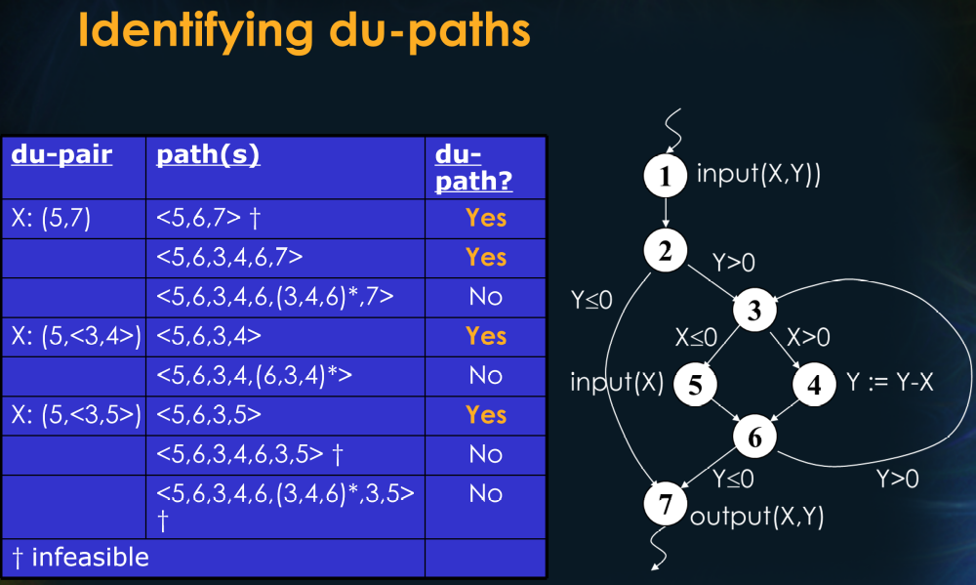

Slide 21
Dataflow Test Coverage Criteria
All-Defs: for every program variable v, at least one def-clear path from every definition of v to at least one c-use or one p-use of v must be covered.

Slide 22
Example
Z=X*2
X=42
2
5
1
4
7
3
6
Z=X-8
All-defs for X
<1,2,4,5>

Slide 23
Dataflow Test Coverage Criteria (cont’d)
Consider a test case executing path:
1. <1,2,3,4,5>
Identify all def-clear paths covered (i.e., subsumed) by this path for each variable.
Are all definitions for each variable associated with at least one of the subsumed def-clear paths?
input(A,B)
1
B>1
B≤1
2
3
A>10
A≤10
4
B := A+B
5
output(A,B)

Slide 24
Def-Clear Paths Subsumed by <1,2,3,4,5> for Variable A
du-pair | path(s)
(1,2) | <1,2> 
(1,4) | <1,3,4>
(1,5) | <1,3,4,5>
 | <1,3,5>
(1,<3,4>) | <1,3,4>
(1,<3,5>) | <1,3,5>
(2,4) | <2,3,4> 
(2,5) | <2,3,4,5> 
 | <2,3,5>
(2,<3,4>) | <2,3,4> 
(2,<3,5>) | <2,3,5>
input(A,B)
1
B>1
B≤1
2
A := A+7
3
A>10
A≤10
4
B := A+B
5
output(A,B)

Slide 25
Def-Clear Paths Subsumed by <1,2,3,4,5> for Variable B
du-pair | path(s)
(1,4) | <1,2,3,4> 
 | <1,3,4>
(1,5) | <1,2,3,5>
 | <1,3,5>
(4,5) | <4,5> 
(1,<1,2>) | <1,2> 
(1,<1,3>) | <1,3>
input(A,B)
1
B>1
B≤1
2
A := A+7
3
A>10
A≤10
4
B := A+B
5
output(A,B)

Slide 26
Dataflow Test Coverage Criteria (cont’d)
Since <1,2,3,4,5> covers at least one def-clear path from every definition of A/B to at least one c-use or p-use of A/B, All-Defs coverage is achieved.

Slide 27
Dataflow Test Coverage Criteria (cont’d)
All-Uses: for every program variable v, at least one def-clear path from every definition of v to every c-use and every p-use of v must be covered.

Slide 28
Example
Z=X*2
X=42
2
5
1
4
7
3
6
Z=X-8
All-defs for X
<1,2,4,5>
All-uses for X
<1,2,4,5> <1,2,4,6>

Slide 29
Dataflow Test Coverage Criteria (cont’d)
Consider additional test cases executing paths:
1. <1,2,3,4,5>
2. <1,3,4,5>
3. <1,2,3,5>
Do all three test cases provide All-Uses coverage?
input(A,B)
1
B>1
B≤1
2
3
A>10
A≤10
4
B := A+B
5
output(A,B)

Slide 30
Def-Clear Paths Subsumed by <1,3,4,5> for Variable A
du-pair | path(s)
(1,2) | <1,2> 
(1,4) | <1,3,4> 
(1,5) | <1,3,4,5> 
 | <1,3,5>
(1,<3,4>) | <1,3,4> 
(1,<3,5>) | <1,3,5>
(2,4) | <2,3,4> 
(2,5) | <2,3,4,5> 
 | <2,3,5>
(2,<3,4>) | <2,3,4> 
(2,<3,5>) | <2,3,5>
input(A,B)
1
B>1
B≤1
2
A := A+7
3
A>10
A≤10
4
B := A+B
5
output(A,B)

Slide 31
Def-Clear Paths Subsumed by <1,3,4,5> for Variable B
input(A,B)
du-pair | path(s)
(1,4) | <1,2,3,4> 
 | <1,3,4> 
(1,5) | <1,2,3,5>
 | <1,3,5>
(4,5) | <4,5> 
(1,<1,2>) | <1,2> 
(1,<1,3>) | <1,3> 
1
B>1
B≤1
2
A := A+7
3
A>10
A≤10
4
B := A+B
5
output(A,B)

Slide 32
Dataflow Test Coverage Criteria (cont’d)
Since none of the three test cases covers the du-pair (1,<3,5>) for variable A, All-Uses Coverage is not provided.

Slide 33
Another Dataflow Test Coverage Criterion
All-DU-Paths: for every program variable v, every du-path from every definition of v to every c-use and every p-use of v must be covered.

Slide 34
Example
Z=X*2
X=42
2
5
1
4
7
3
6
Z=X-8
All-defs for X
<1,2,4,5>
All-uses for X
<1,2,4,5> <1,2,4,6>
All-DU-Paths for X
<1,2,4,5> <1,3,4,5> <1,2,4,6> <1,3,4,6>

Slide 35
Summary of White-Box Coverage Relationships
Complete
Condition Combination
Path
Modified
Condition/Decision
All du-paths
Condition/ Decision
Basis Paths
All-Uses
Loop
Condition
Decision
All-Defs
Statement

